Slide 1
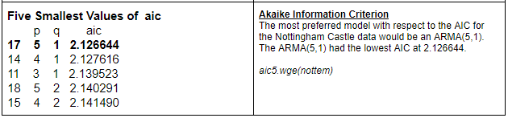
"Unit 5: "For Live Session"
Chad Madding
Use Aic5 to assess the use of ARMA models for your time series. This was added to the Google doc.
AIC On The Nottingham Data

Slide 2
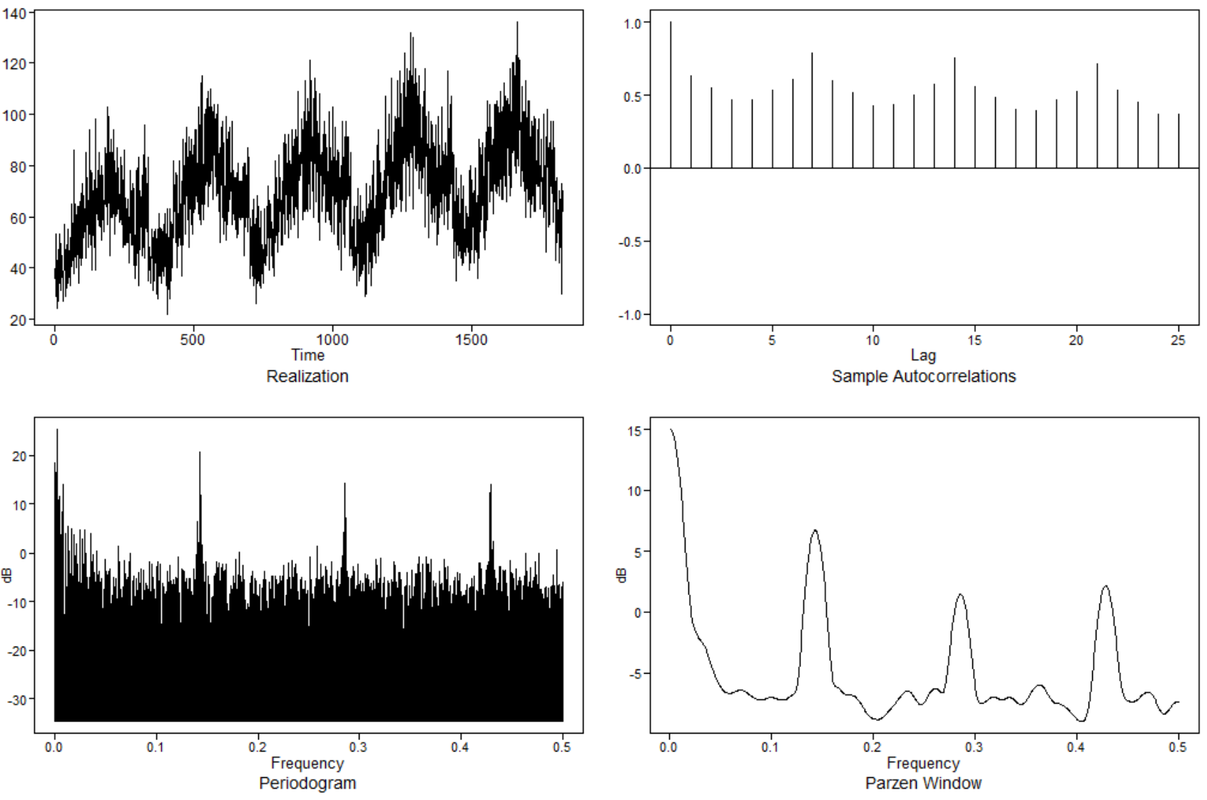
Use Aic5 to assess the use of ARMA models in the Walmart data.
#Find the lowest AIC in the Walmart data
aic5.wge(Store9Item50$sales)
The most preferred model with respect to the AIC for the Wal-Mart store 9 item 50 data is an ARMA(4,2) with an AIC of 4.991650.
Five Smallest Values of aic
p q aic
15 4 2 4.991650
17 5 1 5.009865
18 5 2 5.021469
14 4 1 5.073902
12 3 2 5.114417

Slide 3
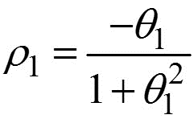
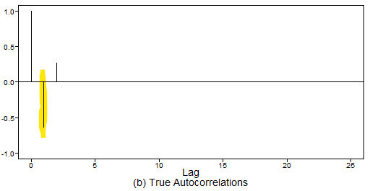
Find ρ1 for the following model by hand. Xt = at–.8at-1 + .5at–2.
-.8/(1+.5) = -.5333
p1 = -.5333
Looking at the above Autocorrelation we can truly see that p1 is -.5333.

Slide 4
Represent the model as a GLP. Xt = at–.8at-1 + .5at–2
GPL Format
X_{t} = 1 + at + (–.8at-1) + (.5at–2)

Slide 5
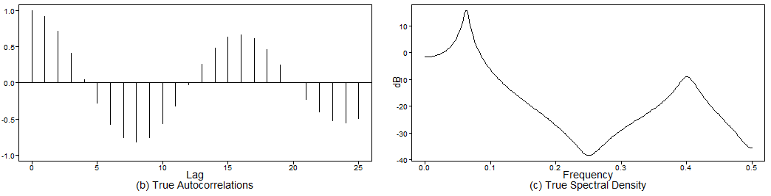
Generate a realizations from an ARMA model. You pick p and q. Include the ACF and spectral density.
#ARMA(4,3)
plotts.true.wge(250, phi = c(.3,.9,.1,-.8075), theta = c(-.9, -.8,-.72))
I chose to generate an ARMA(4,3).
I have included both the True Autocorrelation and the Spectral Density graphs.

Slide 6
Use AIC 5 to identify the top five quality models with respect to AIC for the cancelled flight data from the SWADelay.csv data set (column: arr_cancelled). Comment on which are AR, MA, and ARMA.
# Read in the data
SWA = read.csv("Data/swadelay.csv",header = TRUE)
plotts.wge(SWA$arr_cancelled)
plotts.sample.wge(SWA$arr_cancelled)
aic5.wge(SWA$arr_cancelled)
Five Smallest Values of aic
p q aic
4 1 0 7.371886
3 0 2 7.376428
7 2 0 7.381147
5 1 1 7.381147
2 0 1 7.386961
Here we have the top five quality models with respect to the AIC for the canceled flight data from the SWADelay.csv data set using the arr_cancelled column.
We can see that the top model with respect to the AIC will be an AR(1) model (7.371886). The second is an MA(2) with and AIC of 7.376428. Third will be and AR(2) model with a score of 7.381147. Forth is the only ARMA in the group; it is an ARMA(1,1) and scores a 7.381147. Finally there is an MA(1) that has an AIC of 7.386961.

Slide 7
A brief reflection of thoughts and key takeaways – Week 5

